Slide 1
Test Plan
[B-SORT-1] Add Sort By Filter To Bottom April 27, 2020
Prepared by Adobe Consulting April 2020

Slide 2
Contents
Overview
Design
Specifications
Results

Slide 3
1. Overview

Slide 4
Overview [B-SORT-1] Add Sort By Filter To Bottom
DEVICES All Device Types
LOCATION PackersProShop.com: Product Category Pages
METRICS Primary: Conversion Rate
Secondary: Revenue per Visitor, Average Order Value, Clicks to Sort By (prop20), Product Views, Cart Additions & Checkouts
AUDIENCES All Visitors
REVENUE N/A
HYPOTHESIS
Adding the option to “Sort By” at the bottom of product category pages will make it easier to navigate larger product categories.
BUSINESS OBJECTIVE
Drive conversion rate by giving more exposure to available sorting methods on product category pages.

Slide 5
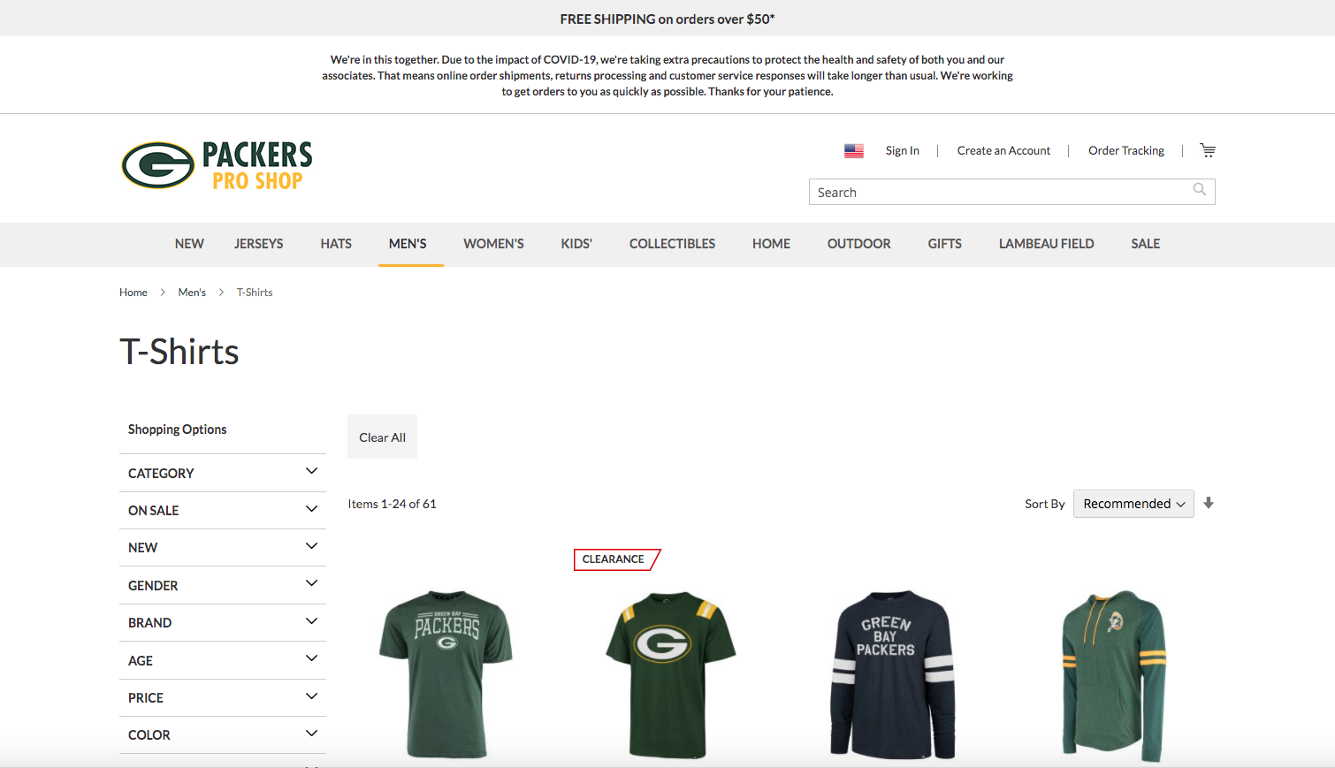
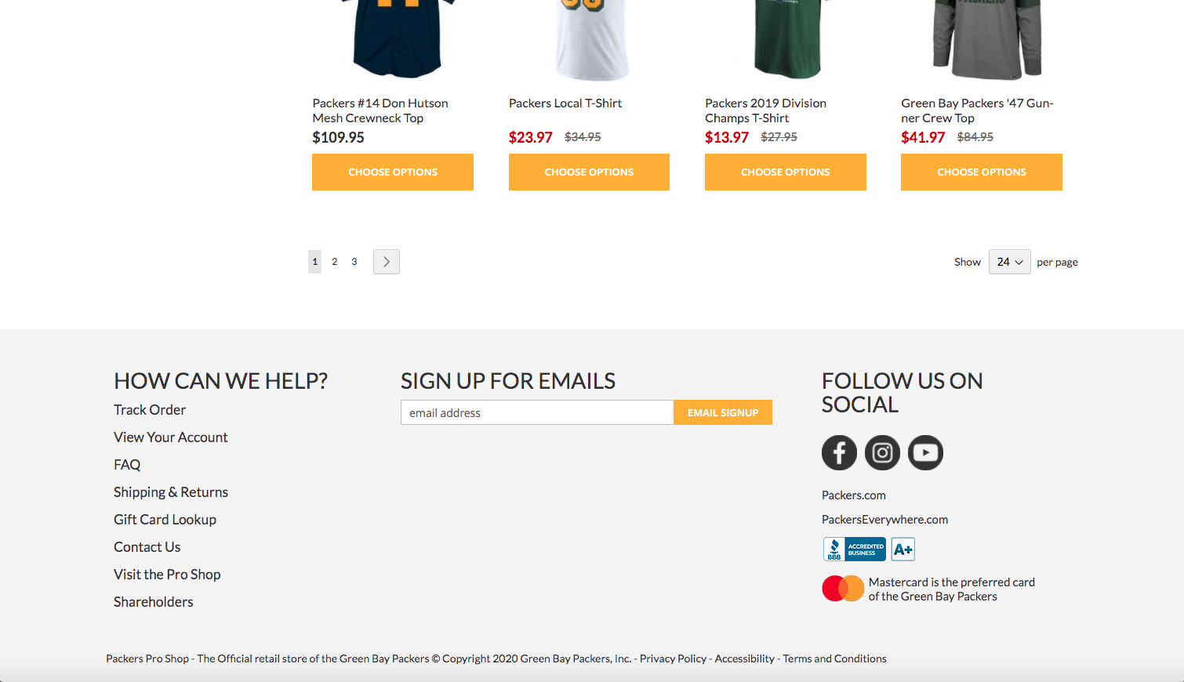
Overview [B-SORT-1] Add Sort By Filter To Bottom
SAMPLE MEN’S T-SHIRTS PCP EXPERIENCES
A – Default Top “Sort By” Filter Only
DEVICES All Device Types
LOCATION PackersProShop.com: Product Category Pages
METRICS Primary: Conversion Rate
Secondary: Revenue per Visitor, Average Order Value, Clicks to Sort By (prop20), Product Views, Cart Additions & Checkouts
AUDIENCES All Visitors to Product Category Pages
REVENUE N/A
B – Add “Sort By” Filter To Bottom

Slide 6
2. Design

Slide 7
Design [B-SORT-1] Add Sort By Filter To Bottom
A – Default Top “Sort By” Only

Slide 8
Design [B-SORT-1] Add Sort By Filter To Bottom
B – Add “Sort By” Filter To Bottom

Slide 9
3. Specifications

Slide 10
Specifications [B-SORT-1] Add Sort By Filter To Bottom
ACTIVITY TYPE A/B
NUMBER OF LOCATIONS URL1 URL2
(pending scope confirm)
CHALLENGERS Add “Sort By Filter” To Bottom of Product Category Pages
TARGETING
All Visitors
VISITORS Segment1: # Per Day (pending scope confirm)
METRICS Primary: Conversion Rate
Secondary: Revenue per Visitor, Average Order Value, Clicks to Sort By (prop20), Product Views, Cart Additions & Checkouts
CONVERSIONS Metric1: # Per Day
Metric2: # Per Day
(pending scope confirm)
TEST DURATION X days to reach significance
(pending scope confirm)

Slide 11
4. Results

Slide 12
Results [X-YY-N] Test Name Here | ##/##/## – ##/##/##
Results Data Graph and/or chart

Slide 13
Results [X-YY-N] Test Name Here | ##/##/## – ##/##/##
[Discovery] | We found that.. |  | X Visitors Metric +$33,747
[Next Step] | We should now do this.. |  | Y Visitors Metric +$5,190
[Next Step] | Implement an enhancement to implementation |  | 4,143,612 Visitors Flat Results No Added Lift
[Recommend] | Test a follow up that does x, y, z |  | Z Visitors Metric +10%
[Recommend] | Consider iterating current design |  | X Visitors Metric +43%

